Slide 1
Introduction to Machine Learning

Slide 2
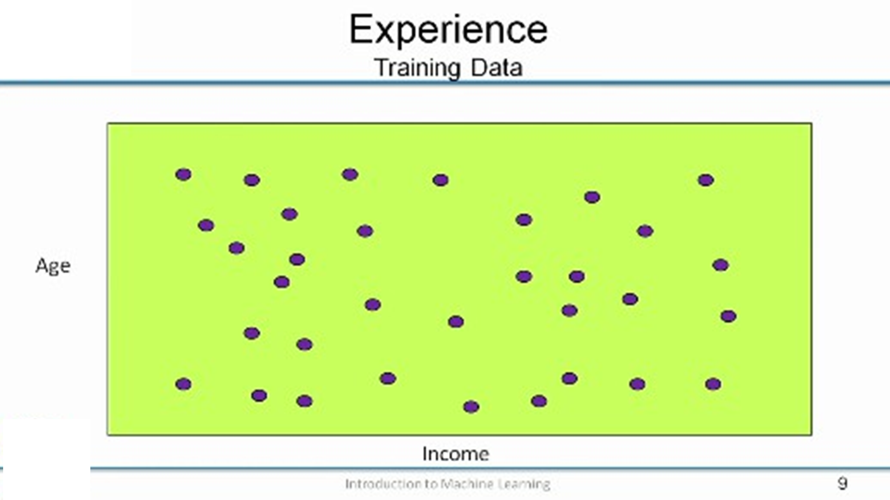

Slide 3
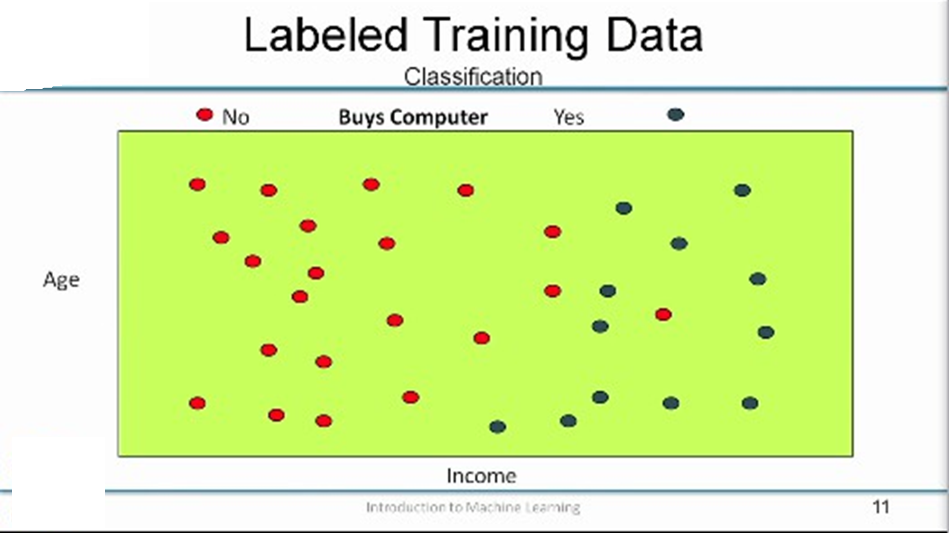
My goal is to predict whether the customer will buy a computer or not buy a computer right. So I have this kind of labeled data that is given to me for building a classifier right
Remember we talked about classification where the output is a discrete value in this case it is yes or no, yes this is the person will buy a computer, no the person will not buy a computer.
so now the goal is to come up with a function right, come up with a mapping that will take the age and income as the input and it will give you an output that says the person will buy the computer or not buy the computer.

Slide 4
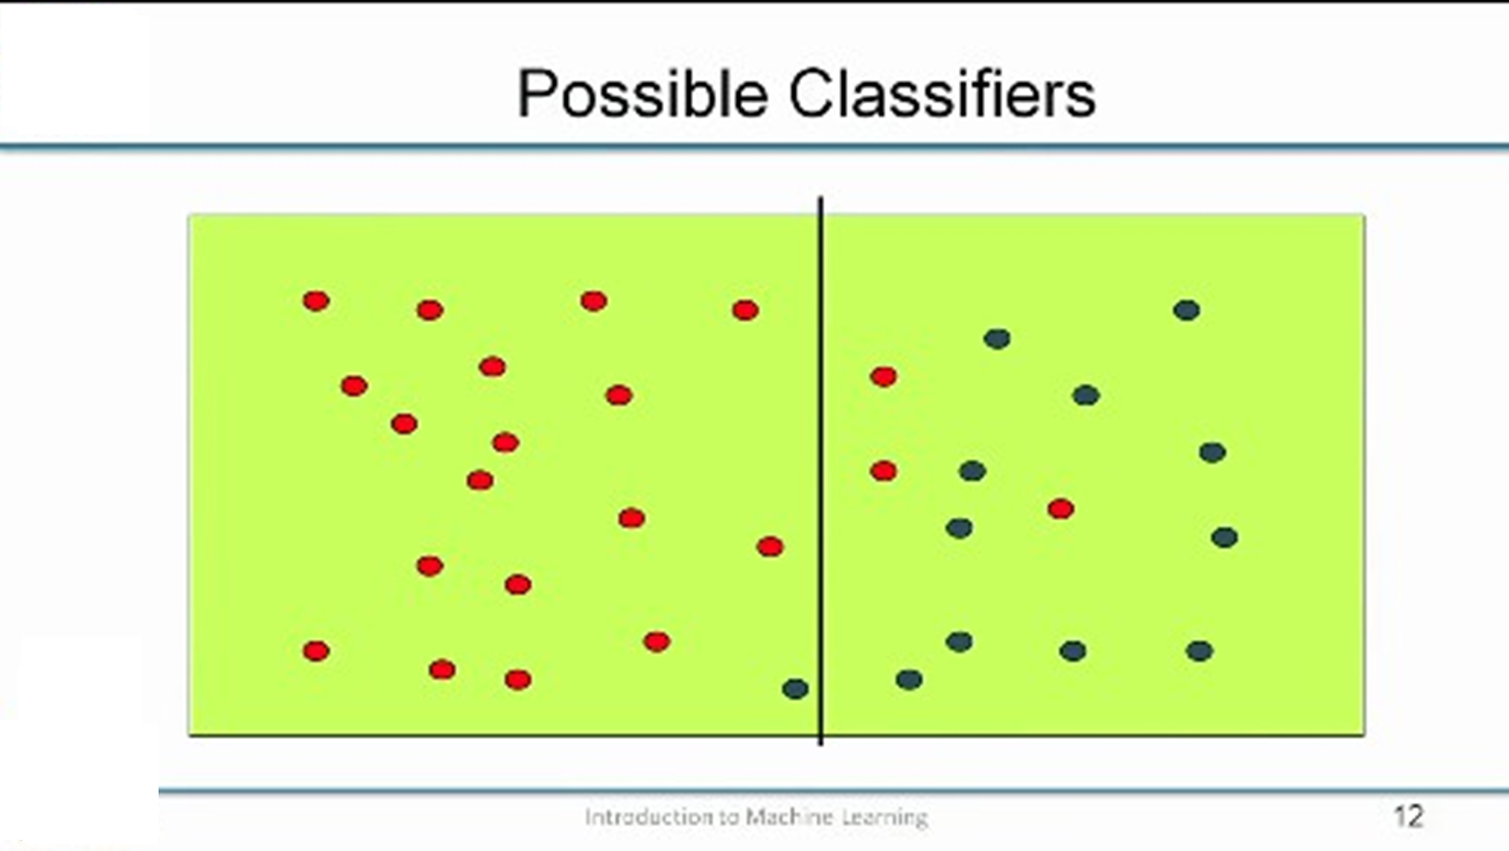
I am looking at data as points in space, one of the most natural ways of thinking about defining this function is by drawing lines or curves on the input space.
So here is one possible example, I have drawn a line and everything to the left of the line are points that are red classified as will not buy a computer, everything to the right of the line where the predominantly the data points are blue will be classified as will buy a computer.
So how would the function look like, it will look like in this case it basically says that if the income of the person is less than some value , less than some X then the person will not buy a computer. If the income is greater than X the person will buy your computer. So that is the kind of a simple function that we will define.

Slide 5
So we are just going by income, if the income is less than some X then the person will not buy a computer, if the income is greater than X the person will buy a computer. So is this a good rule
More or less I mean we get most of the points correct right except a few.
we can survive with this rule.
So this is not too bad right, but then you can do slightly better

Slide 6
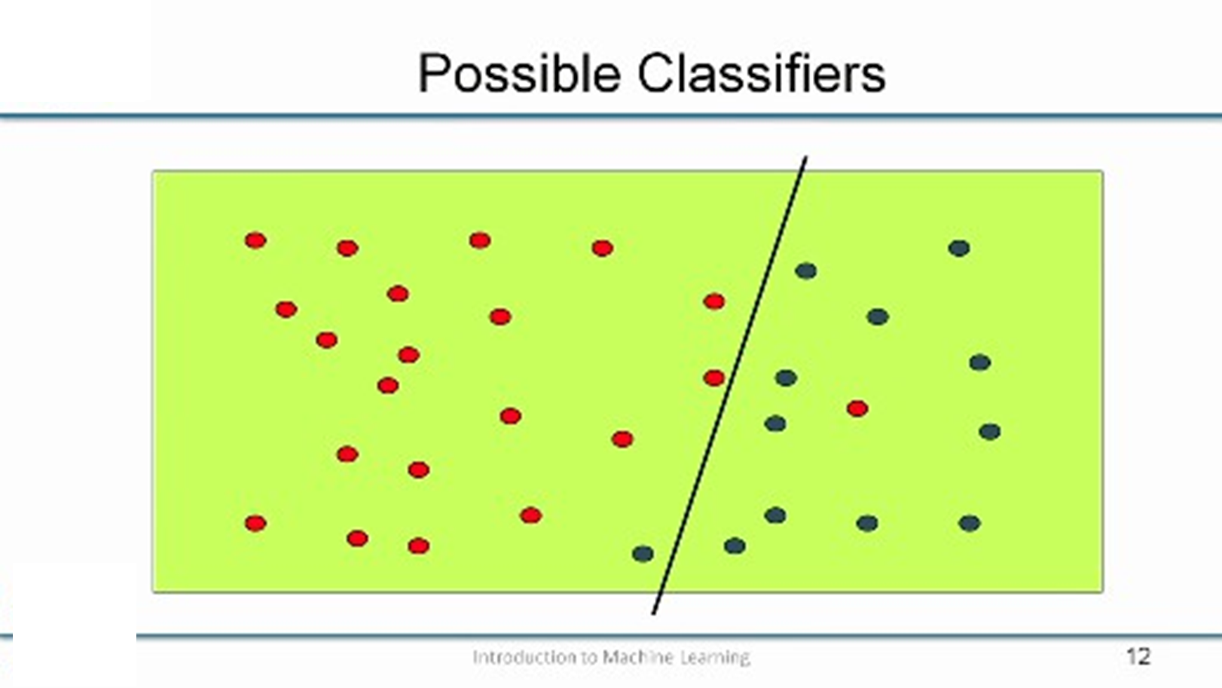
now we have those two red points that just keep that points are on the wrong side of the line earlier now seem to be on the right side right. So everything to the left of this line will not buy a computer, everything to the right will buy a computer right, and everyone moves to the right will buy a computer.
So if you think about what has happened here, so we have improved our performance measure right at the cost of something, so what is the cost here.
So earlier we are only paying attention to income right, but now we have to pay attention to age as well. So the older you are right, the income threshold at which we will buy a computer is higher , the younger you are the income threshold at which you will buy a computer is lower right.
so the older you are, the income threshold is shifted to the
right here.
The older you are, you need to have a higher income before you buy a computer, and the younger you are your income threshold is lower, so you do not mind buying a computer even if your income is slightly lesser.
So now we have to start paying attention to the age right, but then the advantage is you get much better performance right.

Slide 7
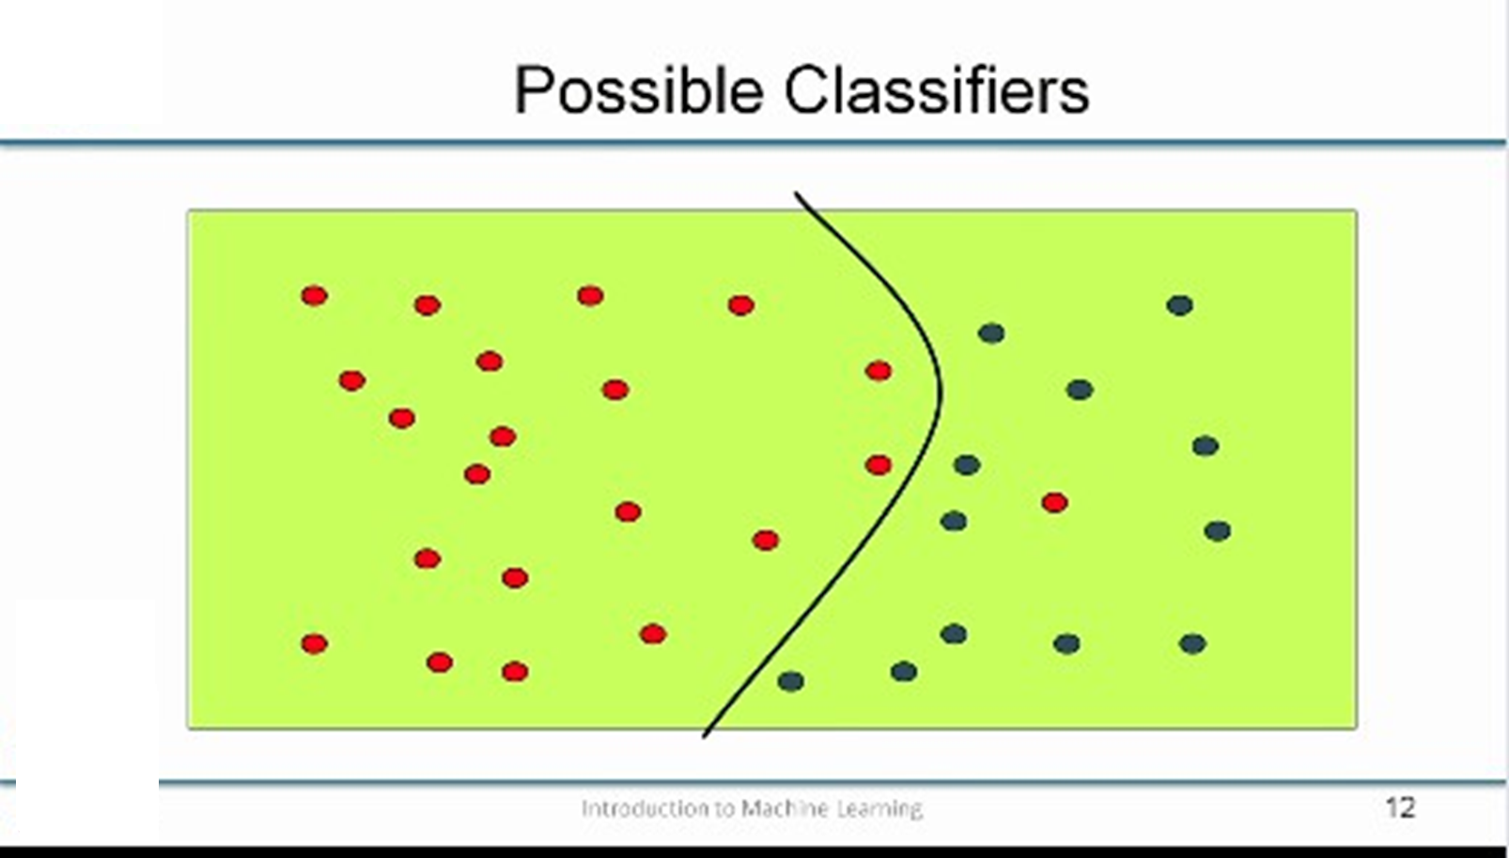
Can you do better than this yes?
Now almost everything is correct except that one pesky red point, but everything else is correct.
And so what has happened here we get much better performance, but at the cost of having a more complex classifier right.
earlier if you thought about it in geometric terms, first you had a line that was parallel to the y-axis therefore, I just needed to define an intercept on the x-axis .
Then the second function was a slanting line like that, so I needed to define both the intercept and the slope .
And now here it is now a quadratic so I have to define three parameters right. So I have to define something like ax²+ bx+c, so I have defined the a, b, c – the three parameters to find the quadratic, and I am getting better performance.

Slide 8
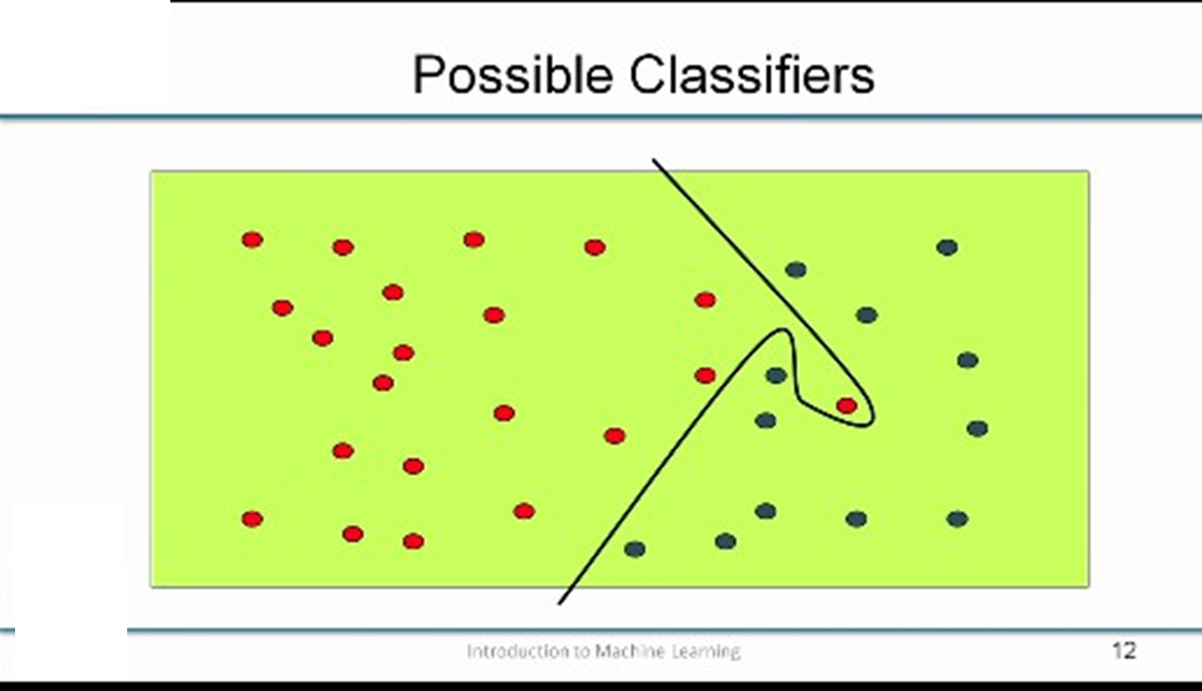
can you do better than this?
that somehow does not seem correct
seems to be too complex a function just to be getting this one point there right.
I am not even sure how many parameters you need for drawing that
I am pretty sure that it is got lot more parameters than it is worth. Another thing to note here is that that particular red point that you see is surrounded by a sea of blue points.
So it is quite likely that there was some glitch there either the person actually bought a computer and we never we have not recorded it has been having bought a computer or there are some extremist reason the person comes into the shop sure that is going to buy a computer but then gets a phone call saying that some emergency please come out immediately and therefore he left without buying a computer right there could be variety of reasons for why that noise occurred and this will probably be the more appropriate classifier right.

Slide 9
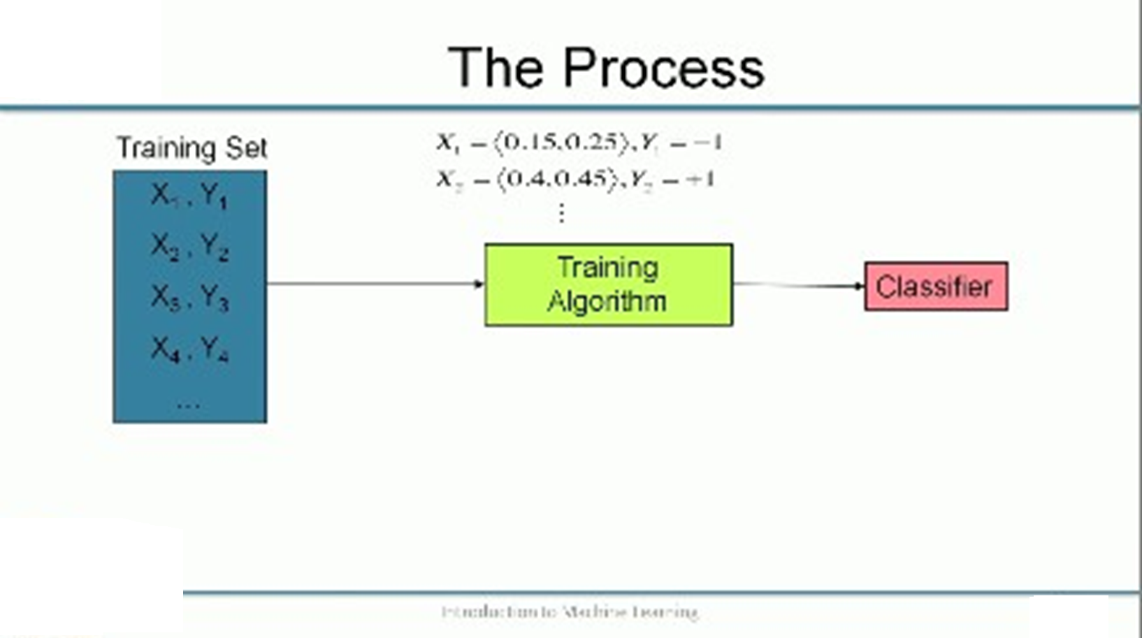
so here is one way of looking at the whole process. I am going to be giving you a set of data which we will call the training set. So the training set will consist of say as an input which we'll call as X and an output which we call Y.
I am going to have a set of inputs X1, X2, X3, X4 likewise I will have Y1, Y2, Y3, Y4, and this data is fed into a training algorithm right and so the data is going to look like this in our case .
And then the training algorithm trains over this data and it will produce a classifier
Now, I do not know whether it is good or bad.
we had a straight line in the first case right an axis parallel line if we did not know the good or bad and we needed to have some mechanism by which we evaluate this.

Slide 10
how do we do the evaluation typically is that you have what is called a test set or validation set.
This is another set of x and y pairs like we had in the training set, again in the test set we know what the labels are it is just that we are not showing it to the training algorithm
we know what the labels are because we need to use the correct labels to evaluate whether your training algorithm is doing good or bad.
This process by which this evaluation happens is called validation. Then at the end of the validation, if you are happy with the quality of the classifier we can keep it. If you are not happy then go back to the training algorithm and say hey I am not happy with what you produced, give me something different.
we have to either iterate over the algorithm again we will go over the data again and try to refine the parameter estimation or we could even think of changing some parameter values and then trying to redo the training algorithm all over again.
But this is the general process and we will see that many of the different algorithms that we look at in the course follow this kind of a process.

Slide 11
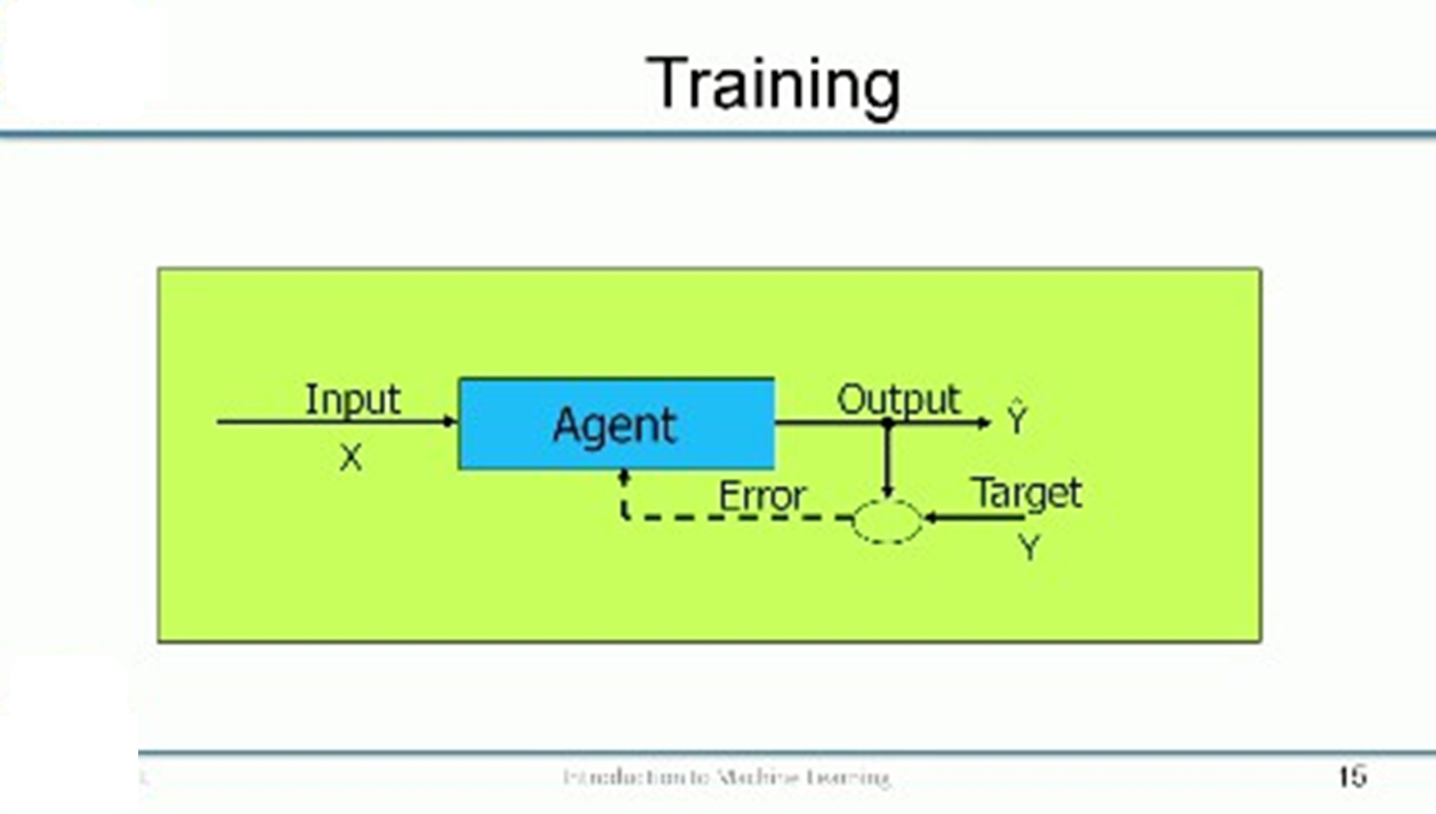
So what happens inside that green box?
inside the training algorithm, there will be this learning agent which will take an input and it will produce an output Ŷ which it thinks is the correct output but it will compare it against the actual target Y it was given in the training.
In the training you actually have a target Y so it will compare it against a target Y and then figure out what the error is and use the error to change the agent.
Then it can produce the right output next time around. This is essentially an iterative process so you see that input produces an output Ŷ and then you take the target Y, you can compare it to the Ŷ.
Figure out what is the error and use the error to change the agent again.
This is by the way most of the learning algorithms will operate; most of the classification algorithms or even regression algorithms will operate and we will see how each of these works as we go on.

Slide 12
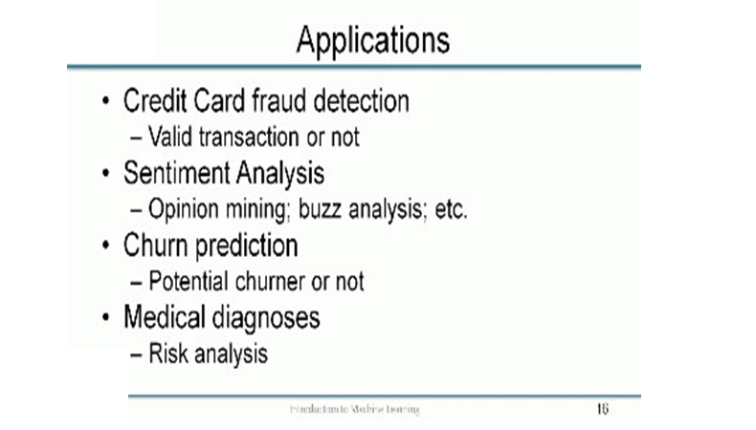

Slide 13
we talked about how we are interested in learning different lines or curves that can separate different classes in supervised learning.
these curves can be represented using different structures and throughout the course, we will be looking at different kinds of learning mechanisms like artificial neural networks, support vector machines, decision trees, nearest neighbors, and Bayesian networks and these are some of the popular ones and we look at these in more detail as the course progresses.
So another supervised learning problem is the one of prediction or regression where the output that you are going to predict is no longer a discrete value it is not like – will buy a computer or does not buy a computer – it is more of a continuous value
so here is an example, where at different times of day you have recorded the temperature so the input to the system is going to be the time of day and the output from the system is going to be the temperature that was measured at a particular point at the time.

Slide 14
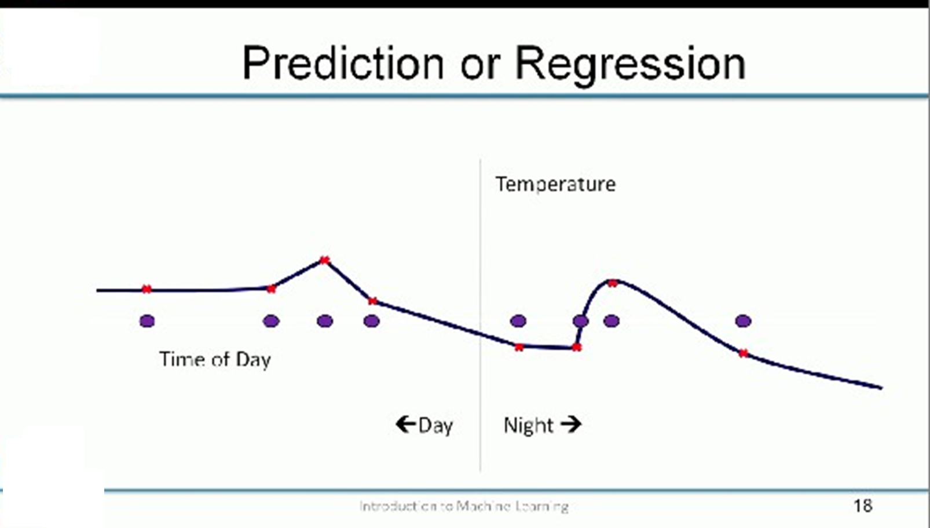
So you are going to get your experience or your training data is going to take this form so the blue points would be your input and the red points would be the outputs that you are expected to predict.
So note here that the outputs are continuous or real values and so you could think of this example as points to the left being day and the points to the right being night.
And just as in the previous case of classification, so we could try to do this as simply as possible fit.
in this case which would be to draw a straight line that is as close as possible to these points now you do see that like in the classification case when it choose a simple solution there are certain points at which we are making large errors right so we could try to fix that.

Slide 15
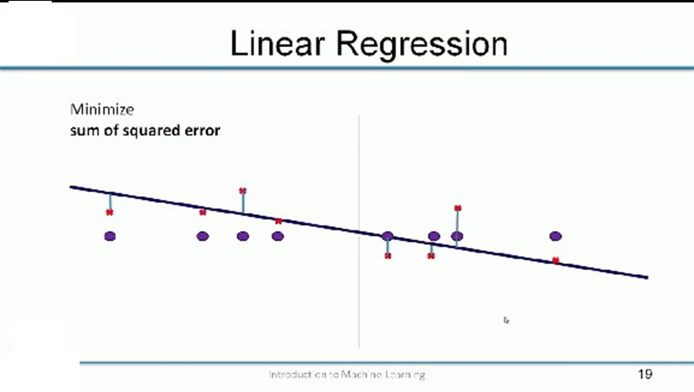
How if you could do something more complex just like in the classification case where we wanted to get that one point right so we could try and fit all these temperatures that were given to us by looking at a sufficiently complex curve.
Again this as we discussed earlier is probably not the right answer and you are probably in this case surprisingly or better off fitting the straight line.
So these kinds of solutions where we try to fit the noise in the data we are trying to make the solution predict the noise in the training data correctly are known as over fitting.
over fit solutions and one of the things that we look to avoid in machine learning is to over fit to the training data. So we will talk about this again in due course.

Slide 16
So what we do is typically we would like to do what is called linear regression some of you might have come across this under different circumstances and the typical aim in linear regression is to say take the error that your line is making so if you take an example point, let us say I take any I take an example point somewhere here right.
So this is the actual training data that is given to you and this is the prediction that your line is making at this point so this quantity is essentially the prediction error that this line is making and so what you do is you try to find that line that has the least prediction error right so you take the square of the errors that your prediction is making and then you try to minimize the, the sum of the squares of the errors.
Why do we take the squares? Because errors could be both positive or negative and we want to make sure that you are minimizing that regardless of the sign of the error okay.
So with sufficient data right so a linear regression is simple enough you could just solve it using matrix inversions as we will see later but with many dimensions, the challenge is to avoid overfitting like we talked about earlier and then there are many ways of avoiding this.

Slide 17
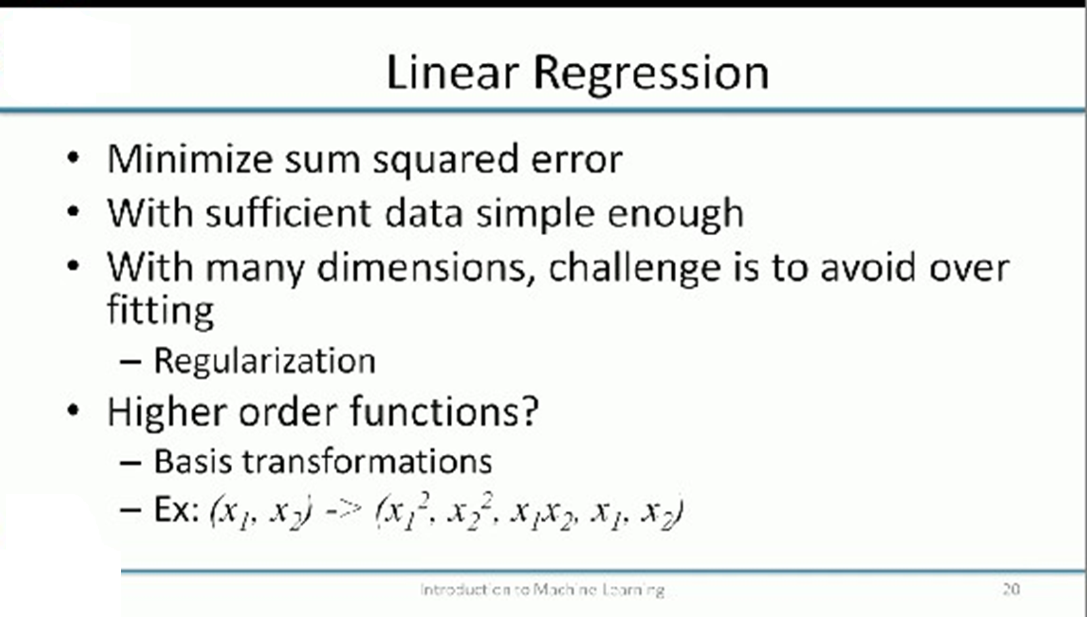

Slide 18
